Slide 1
Active Noise Cancellation Using the LMS and FxLMS algorithms
November 7, 2016
Marko Stamenovic
Recurse Center Lightning Talk
https://github.com/markostam

Slide 2
Background and Motivation
Let’s start at the beginning

Slide 3
Background
Active Noise Cancellation (ANC)
Technique which uses destructive interference to cancel unwanted noise signals.
Machine learning algorithms are employed to quickly learn the characteristics of the unwanted signal in near real time.

Slide 4
Benefits over passive attenuation
Lighter weight and smaller than passive noise attenuation.
Targets specific frequencies.
Actively adapts to offending noise spectrum.

Slide 5
Limitations
Expensive.
Not good with impulsive sounds.
Relatively complex (requires specialized hardware and software).
Requires constant power supply.

Slide 6

System Overview
Equations & block diagrams ahead

Slide 7
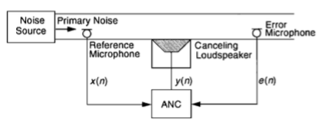
Conceptual System Overview

Slide 8
Conceptual System Overview

Slide 9
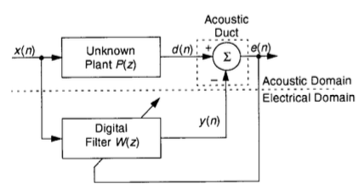
LMS for ANC Block Diagram
Unknown plant P(z) is the transfer function b/w engine and passenger in car our outside world and ears in headphones.
As e(n) approaches 0, W(z) becomes equal to P(z)

Slide 10
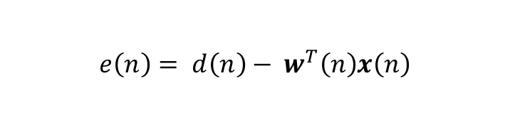
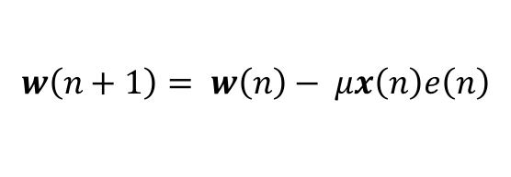
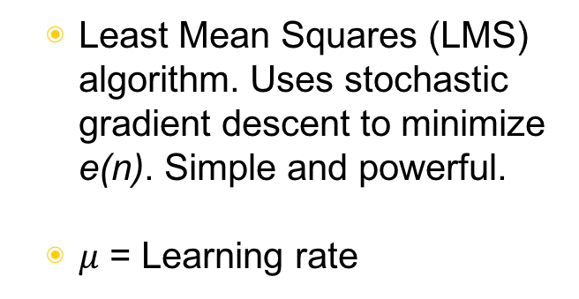
LMS for ANC Equations
$$e\left(n\right)= d\left(n\right)− w^{T}\left(n\right)x\left(n\right)$$
$$w\left(n+1\right)= w\left(n\right)− μx\left(n\right)e\left(n\right)$$
Least Mean Squares (LMS) algorithm. Uses stochastic gradient descent to minimize e(n). Simple and powerful.
$μ$ = Learning rate

Slide 11
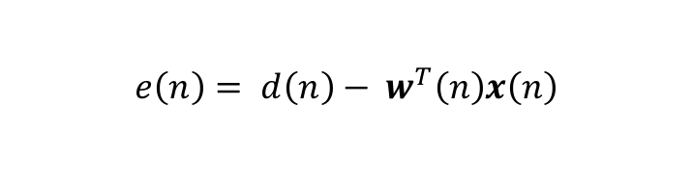
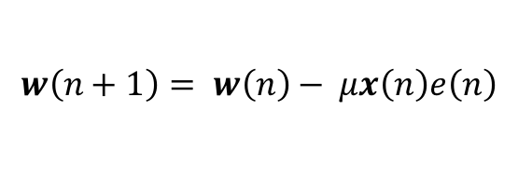
LMS for ANC Block Diagram and Equations
error e(n)
$$e\left(n\right)= d\left(n\right)− w^{T}\left(n\right)x\left(n\right)$$
$$w\left(n+1\right)= w\left(n\right)− μx\left(n\right)e\left(n\right)$$

Slide 12
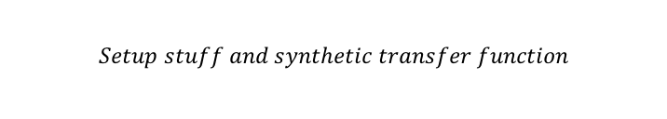
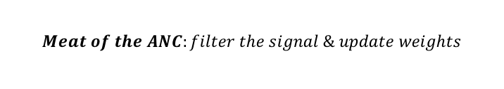
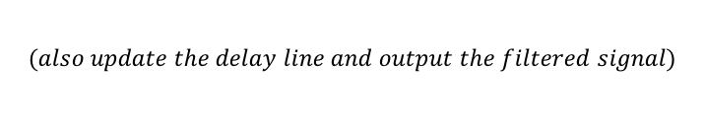
Cool story, show me dez code
$$Setup stuff and synthetic transfer function$$
$$Meat of the ANC:filter the signal \& update weights$$
yn=0.0;
x[0] = refnoise;
for (i = 0; i < N; i++) // compute adaptive filter output (w'x)
{
yn += (weights[i] * x[i]);
}
error = - yn; // compute error
for (i = N-1; i >= 0; i--) // update weights and delay line
{
weights[i] = weights[i] + mu*error*x[i];
x[i] = x[i-1];
}
codec_data.channel[LEFT]= ((uint16_t)(error));
codec_data.channel[RIGHT]= ((uint16_t)(error));
output_sample(codec_data.uint);
return;
}
interrupt void interrupt4(void)
{
short i;
float input, refnoise, signal, signoise, wn, yn, error;
codec_data.uint = input_sample();
refnoise =(codec_data.channel[LEFT]); // noise sensor
input = refnoise;
for (i=0; i < N; i++)
// filter refnoise to emulate transfer
// function of firewall (3rd order lp filter)
{
wn = input - a[i][1]*w[i][0] - a[i][2]*w[i][1];
yn = b[i][0]*wn + b[i][1]*w[i][0] + b[i][2]*w[i][1];
w[i][1] = w[i][0];
w[i][0] = wn;
input = yn;
}
$$(also update the delay line and output the filtered signal)$$

Slide 13
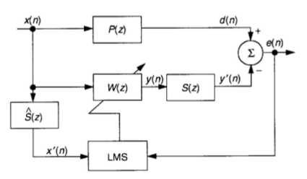
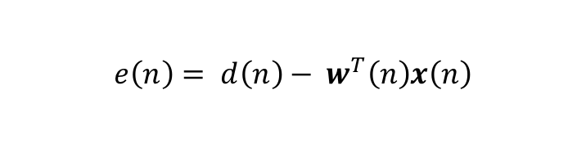
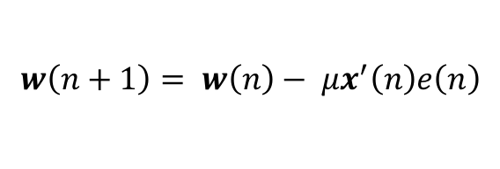
FxLMS Block Diagram
$$e\left(n\right)= d\left(n\right)− w^{T}\left(n\right)x\left(n\right)$$
$$w\left(n+1\right)= w\left(n\right)− μx^{′}\left(n\right)e\left(n\right)$$
One thing missing from the LMS model in practical ANC applications is the path from the speakers to the ear for the correction signal.
This is called the Secondary Path or S(z).
The FxLMS or Filtered LMS algorithm takes care of the secondary path.

Slide 14
FxLMS Block Diagram
$$e\left(n\right)= d\left(n\right)− w^{T}\left(n\right)x\left(n\right)$$
$$w\left(n+1\right)= w\left(n\right)− μx^{′}\left(n\right)e\left(n\right)$$
By adding in a filter Ŝ(z) equal to S(z), we can account for the secondary path signal.
Ŝ(z) is learned by playing a known excitation signal through the LMS block diagram shown previously.

Slide 15
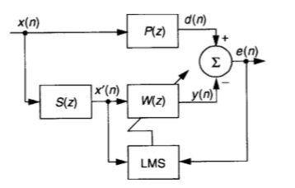
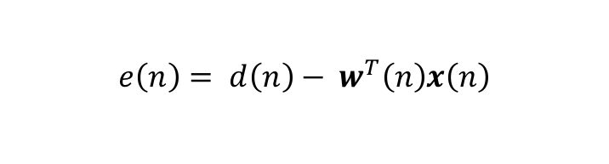
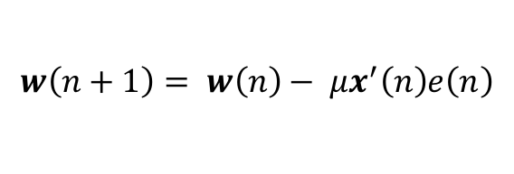
FxLMS Block Diagram
$$e\left(n\right)= d\left(n\right)− w^{T}\left(n\right)x\left(n\right)$$
$$w\left(n+1\right)= w\left(n\right)− μx^{′}\left(n\right)e\left(n\right)$$

Slide 16
Experimental Results
4

Slide 17
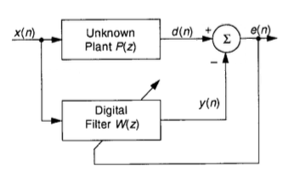
Experimental Setup
Unknown plant P(z) is modeled by a digital LPF.
Input x(n) is pink noise.
Stays in digital domain so there is no secondary path.

Slide 18
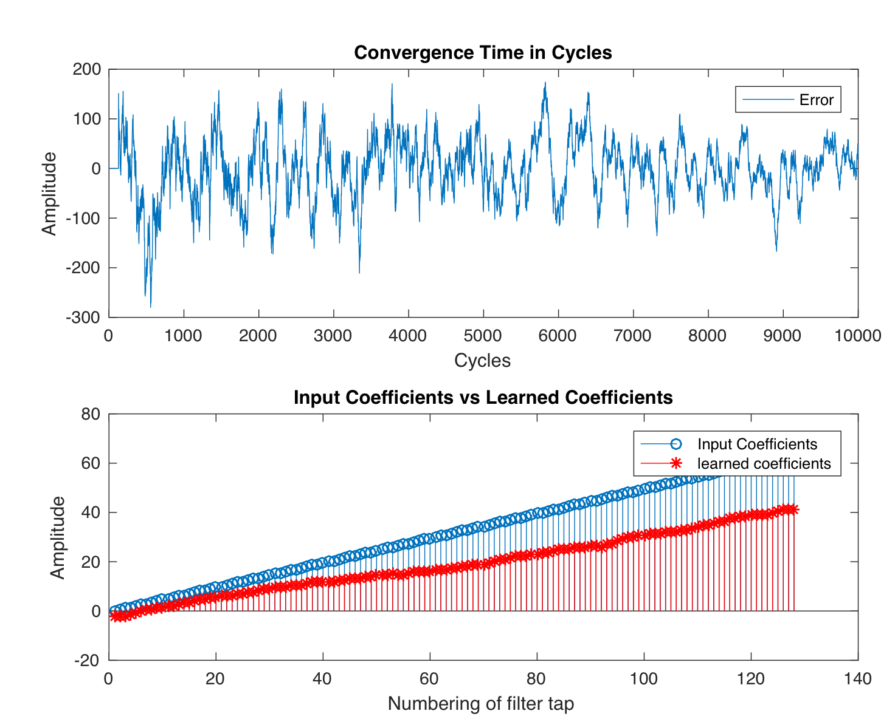
Learning Rate Too Small
µ = 0.002

Slide 19
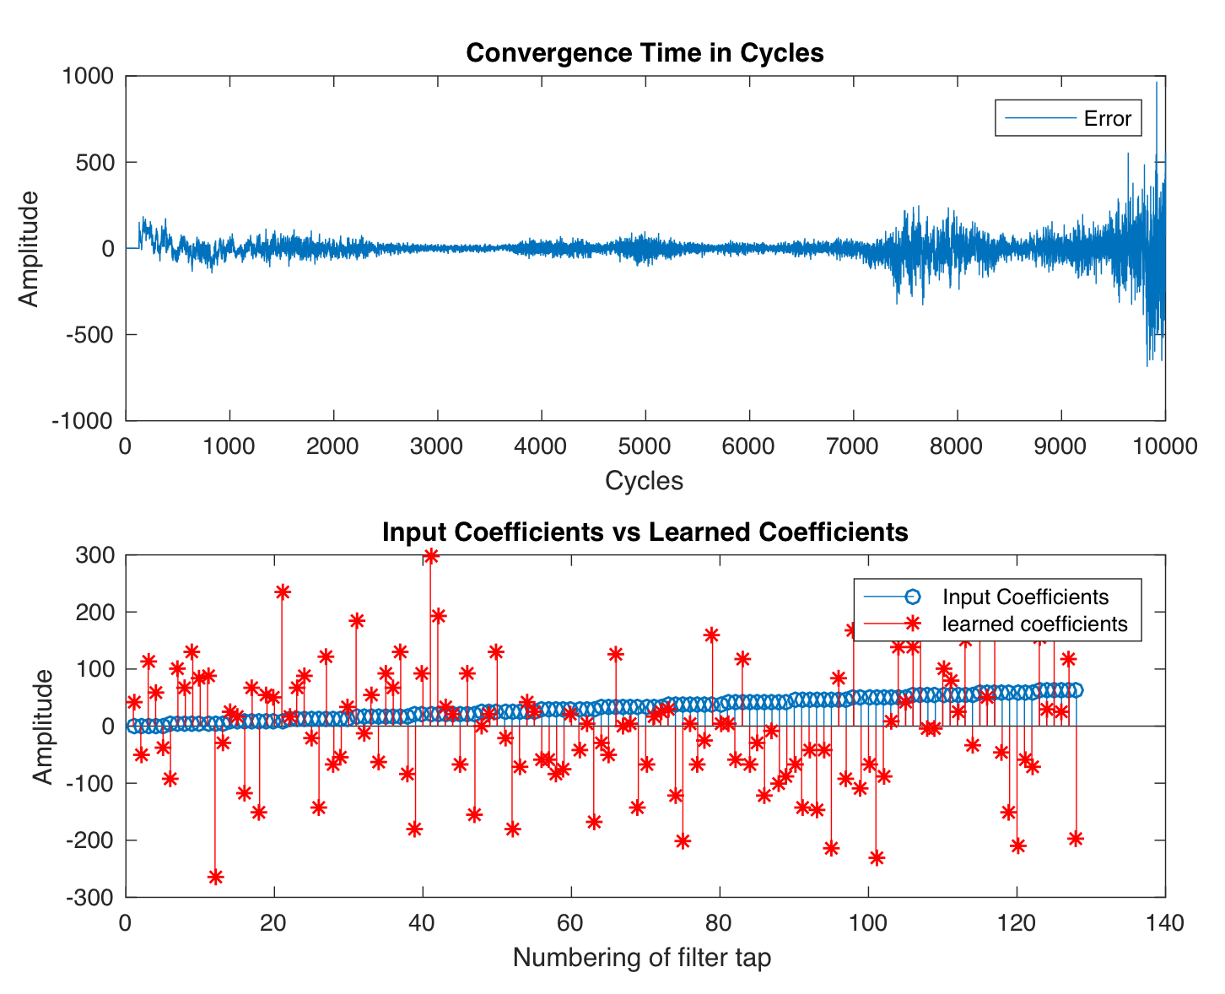
Learning Rate Too Large
µ = 2.6

Slide 20
Learning Rate Juust Right
µ = 1.3

Slide 21
Demo Time!!!!!!!!!!!!!!!!!!!!!!
5

Slide 22

Yes, it’s really time for the:
Long learning rate
Fast learning rate

Slide 23
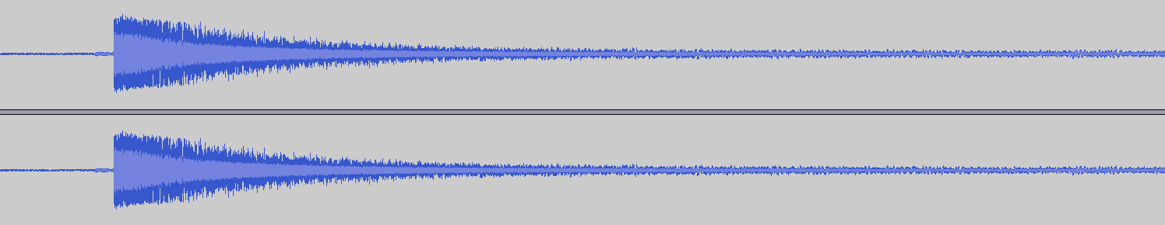
Output Waveform
Not Perfect Attenuation
But a lot better than a full
pink noise waveform.

Slide 24
Thanks!
Any questions ?
Find me at:
markostam@gmail.com
Find my code at:
https://github.com/markostam/active-noise-cancellation

